Slide 1







IOT WORKLOAD CHARACTERIZATION IN NEXT GENERATION CLOUD SYSTEMS UPDATE
Supervised by: Dr. Karan Mitra, Dr. Saguna Saguna,
Dr. Christer Åhlund
Presented by: Fatema Mirza

Slide 2






Introduction
TABLE OF CONTENTS
Distribution Per day half hour only
Findings & Next steps
Distribution Per day basis only
Distribution Per day hour only
fatmir-0@student.ltu.se

Slide 3
01
Latest additions
fatmir-0@student.ltu.se

Slide 4
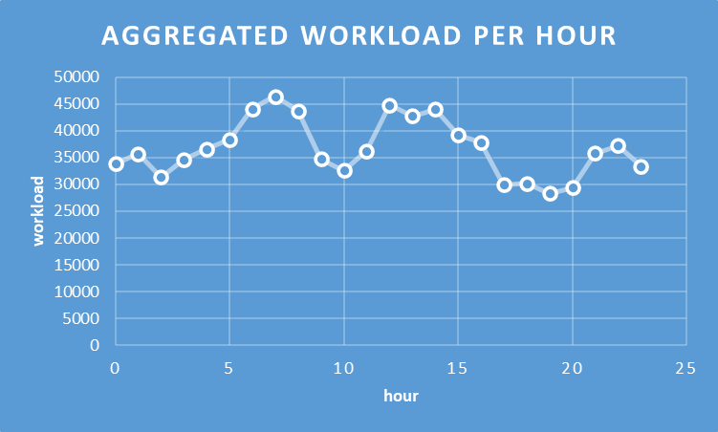
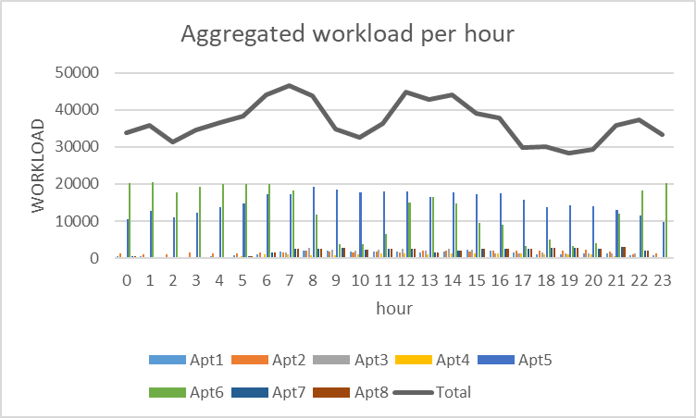
Aggregated Workload per hour
fatmir-0@student.ltu.se 11/02/2022 | 07

Slide 5
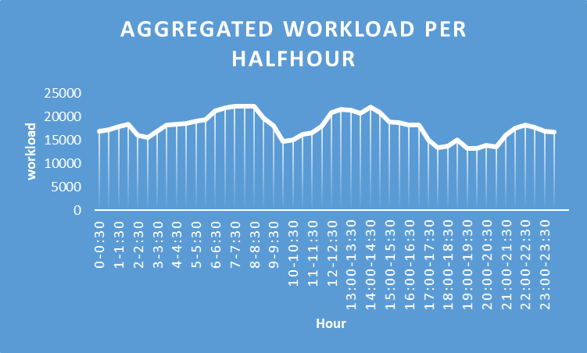
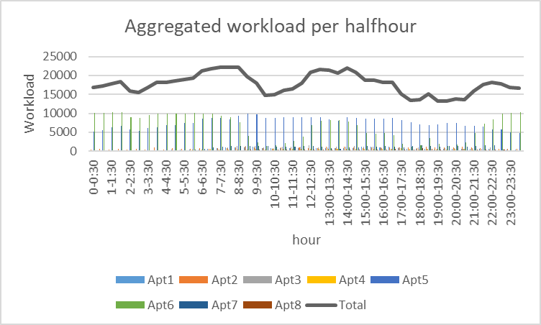
Aggregated Workload per half-hour
fatmir-0@student.ltu.se 11/02/2022 | 09

Slide 6









Housing complex
TV plug had misfired
fatmir-0@student.ltu.se 11/02/2022 | 01

Slide 7
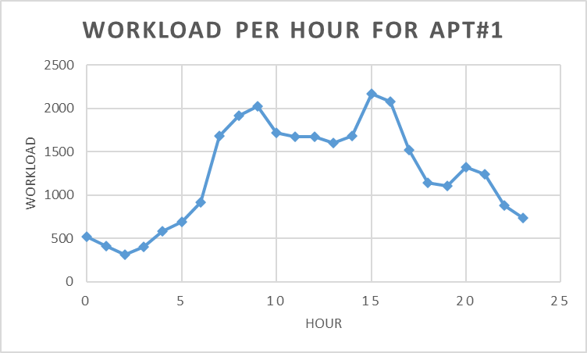
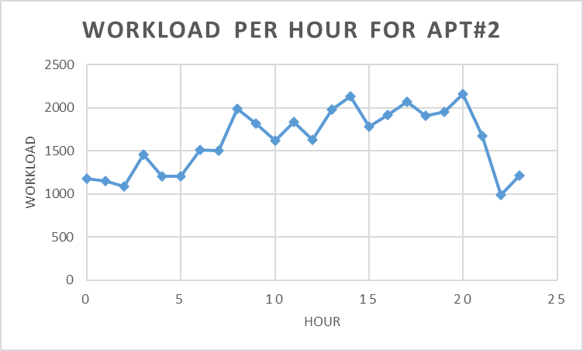
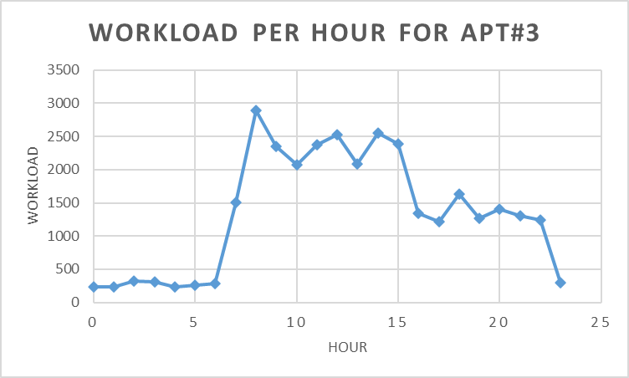
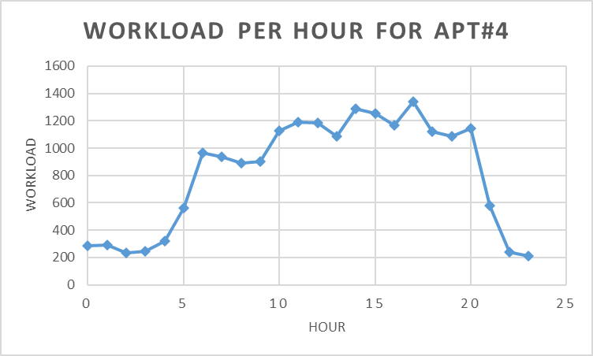

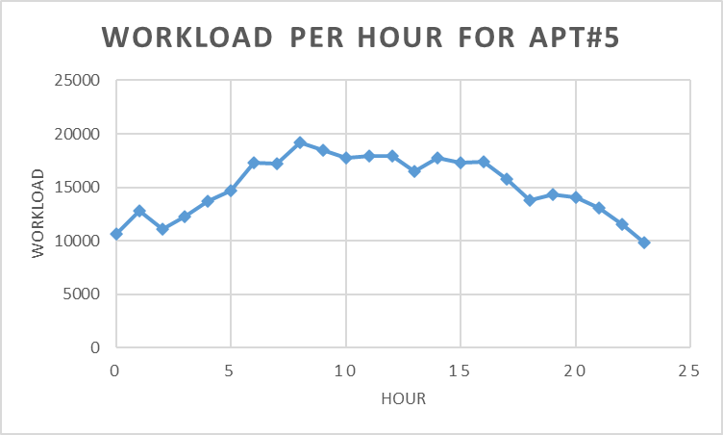
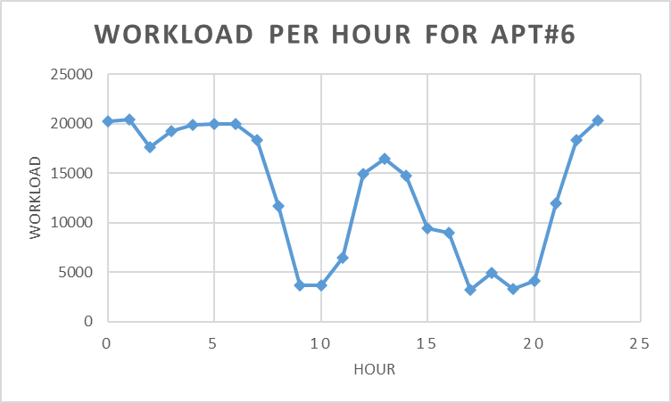
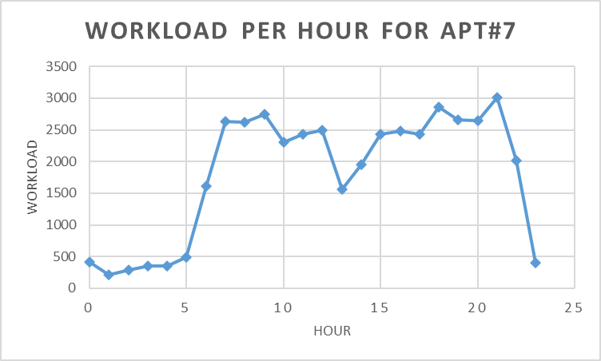
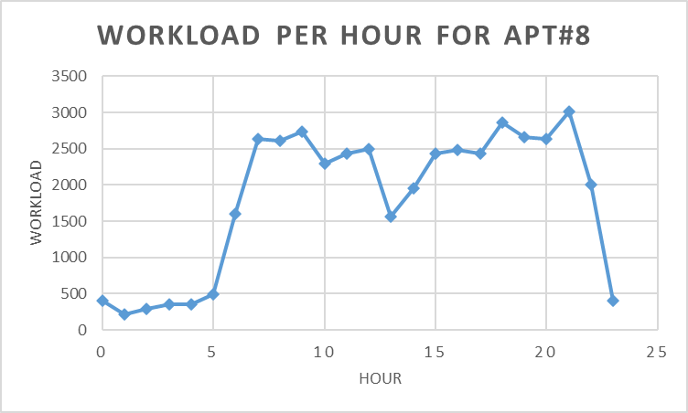
Workload per hour per apartments
fatmir-0@student.ltu.se 11/02/2022 | 06

Slide 8
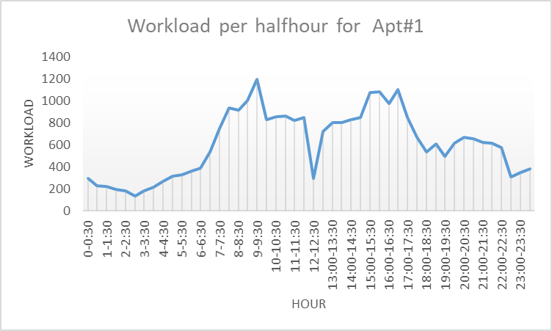
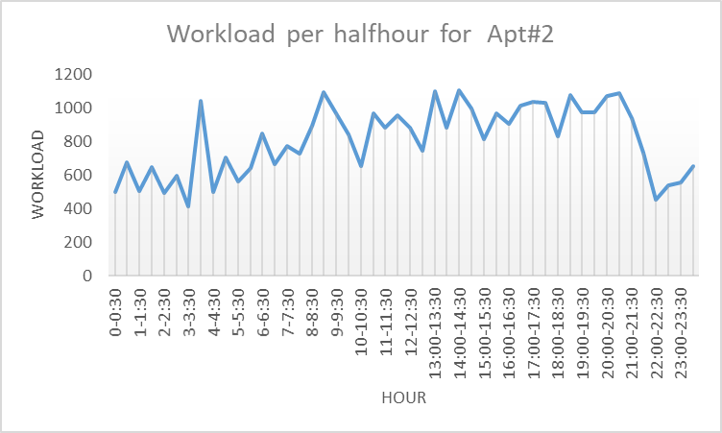
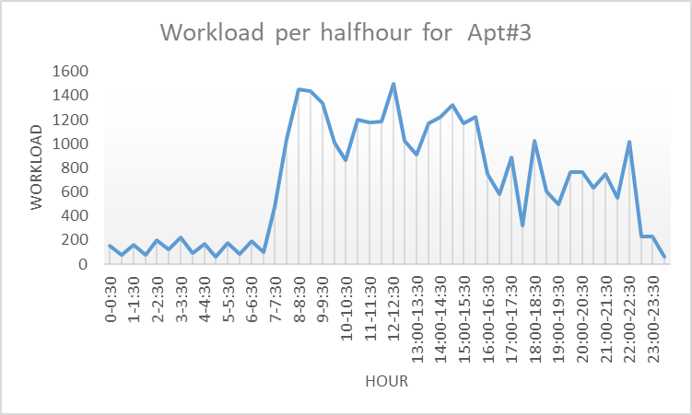
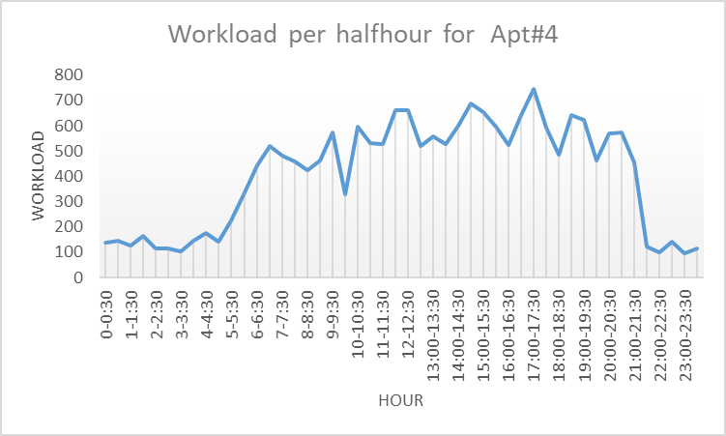
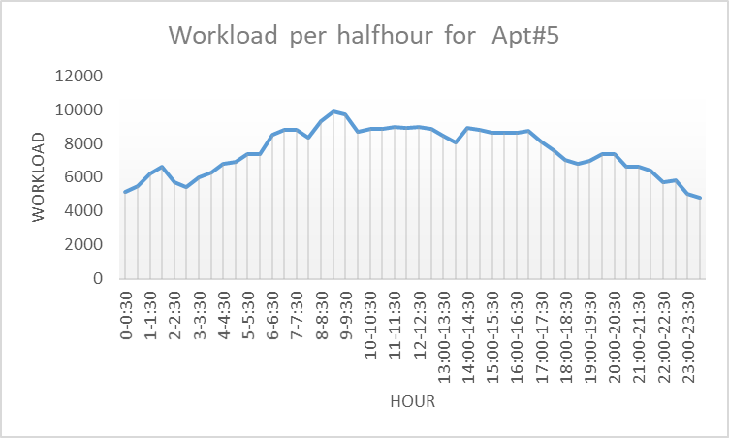
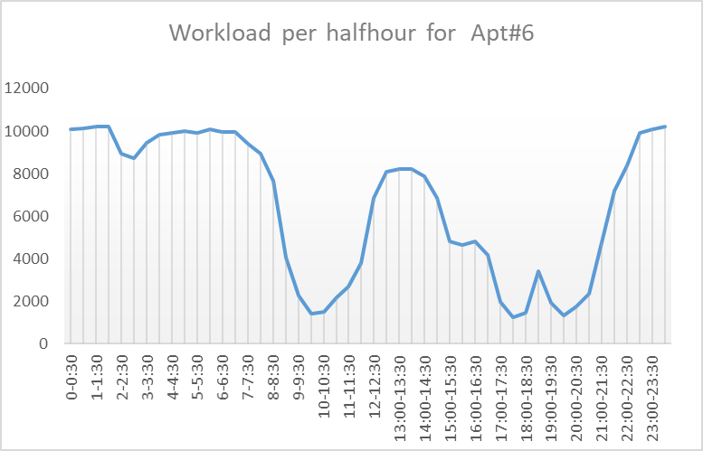
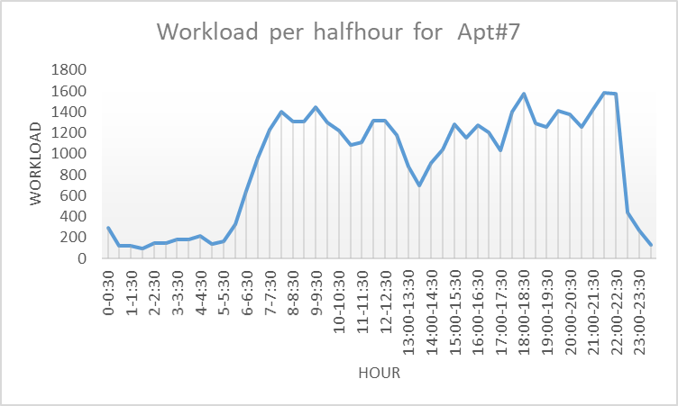
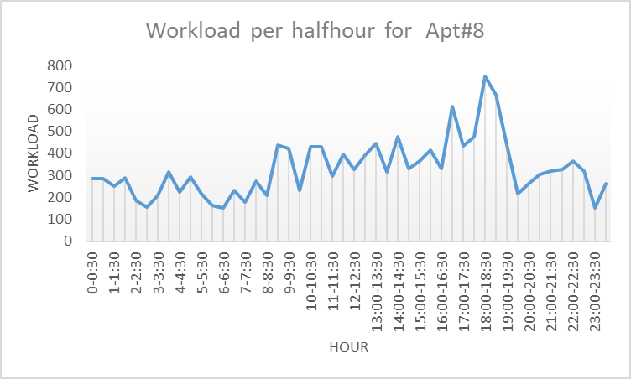
Workload per half hour per apartments
fatmir-0@student.ltu.se 11/02/2022 | 08

Slide 9
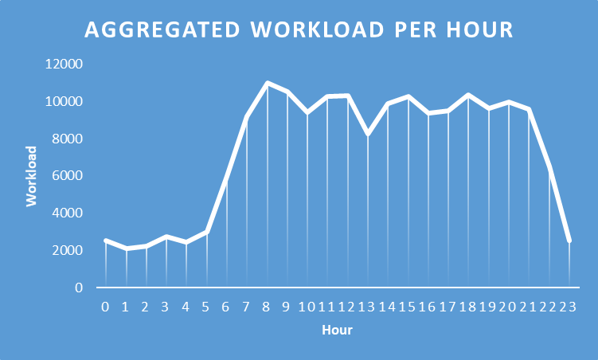
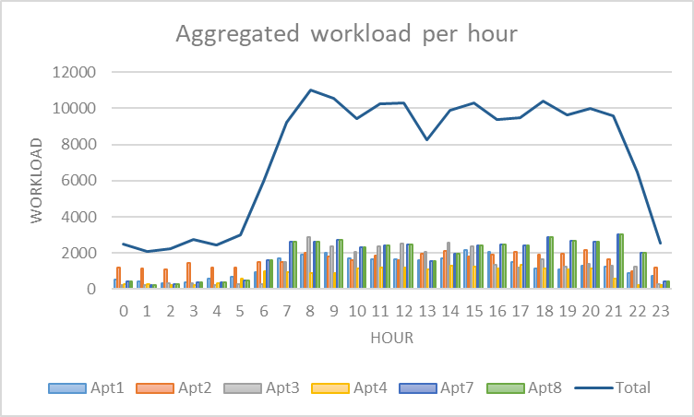
Aggregated Workload per hour
fatmir-0@student.ltu.se 11/02/2022 | 07

Slide 10
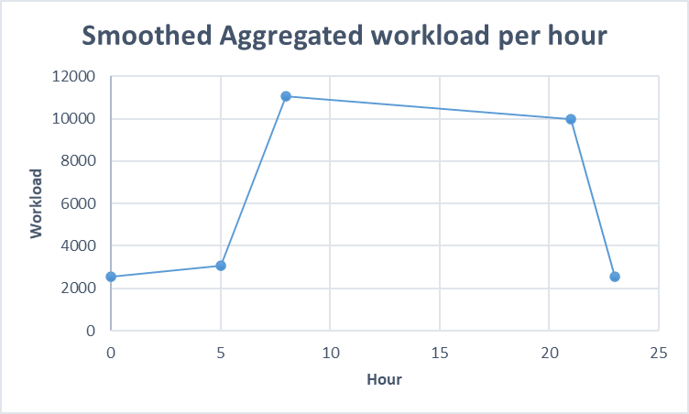

Smoothing aggregated workload per hour
{
^{If 0<=x<5, y=100x+2550}
^{If 5<=x<8, y=8000/3x-30850/3}
If 8<=x<21, y=-1050/13x+152050/13
If 21<=x<24, y=-7450/3x+6.215000e+04
}
fatmir-0@student.ltu.se 11/02/2022 | 10

Slide 11
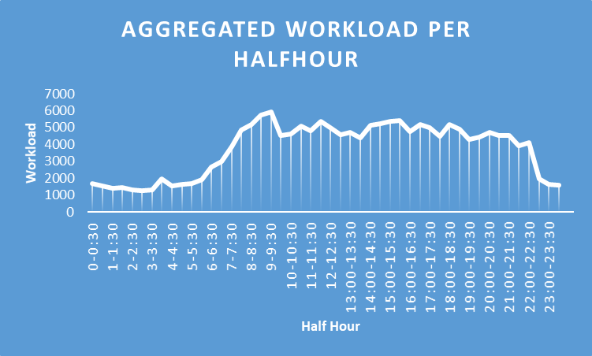
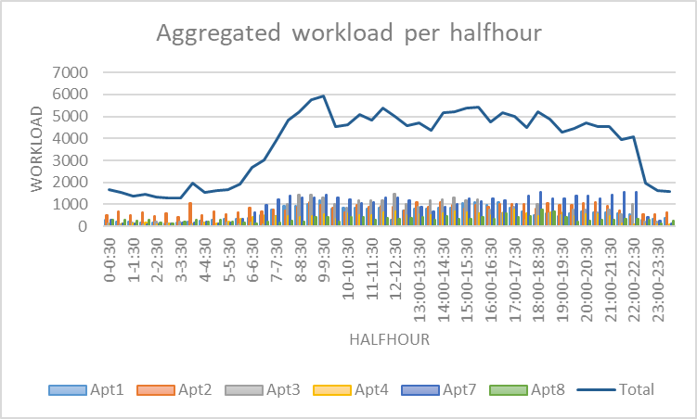
Aggregated Workload per half-hour
fatmir-0@student.ltu.se 11/02/2022 | 09

Slide 12
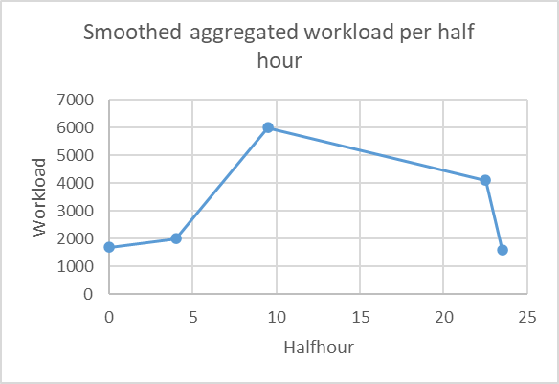
Smoothing aggregated workload per half hour
{
^{If 0<=x<4, y=75x+1700}
If 4<=x<9.5, y=8000/11x-10000/11
If 9.5<=x<22.5, y=-1900/13x+96050/13
If 22.5<=x<24, y=-1900/13x+96050/13
}
fatmir-0@student.ltu.se 11/02/2022 | 10

Slide 13
Next steps
^{Look into log function}
^{Look into linear regression}
Look into nonlinear and curved regression
fatmir-0@student.ltu.se 11/02/2022 | 10

Slide 14

Thank you! Tack så mycket
Any Questions?
fatmir-0@student.ltu.se

Slide 15
References
[1] https://www.youtube.com/watch?v=SqSUJ0UYWMQ
[2] https://techcrunch.com/2014/11/08/littles-law-is-big-for-startups/?guccounter=1&guce_referrer=aHR0cHM6Ly93d3cuZ29vZ2xlLmNvbS8&guce_referrer_sig=AQAAAFvY4BNr5Vvu2uDhXO4VTDuLiVSsISoGSjMxJMxW1Pt6ar11_kEY1wq5aw5HlXlySpE0jUAVwaZrqBu00JlSq7EUCeucjIMrTrHpRp59P000WKfozg64v5gANPPBZ1cB1W72iB8KG7aZ9xlUhU3E68QBMT2CsMngoCUV5UZ2HcNW
[3] Konstantopoulos, T. A review of Burke’s theorem for Brownian motion. Queueing Syst 83, 1–12 (2016). https://doi.org/10.1007/s11134-016-9478-x
[4] Chen H., Yao D.D. (2001) Jackson Networks. In: Fundamentals of Queueing Networks. Stochastic Modelling and Applied Probability, vol 46. Springer, New York, NY. https://doi.org/10.1007/978-1-4757-5301-1_2
[5] M. López-Benítez, C. Majumdar and S. N. Merchant, "Aggregated Traffic Models for Real-World Data in the Internet of Things," in IEEE Wireless Communications Letters, vol. 9, no. 7, pp. 1046-1050, July 2020, doi: 10.1109/LWC.2020.2980272.
[6] M. López-Benítez, C. Majumdar and S. N. Merchant, "Aggregated Traffic Models for Real-World Data in the Internet of Things," in IEEE Wireless Communications Letters, vol. 9, no. 7, pp. 1046-1050, July 2020, doi: 10.1109/LWC.2020.2980272.
[7] ing Yuan, Yu Zheng, Chengyang Zhang, Wenlei Xie, Xing Xie, Guangzhong Sun, and Yan Huang. Tdrive: driving directions based on taxi trajectories. In Proceedings of the 18th SIGSPATIAL International
Conference on Advances in Geographic Information Systems, GIS ’10, pages 99{108, New York, NY, USA,
2010. ACM.
[8] Huang, Jiwei & Li, Songyuan & Chen, Ying & Chen, Junliang. (2018). Performance modelling and analysis for IoT services. International Journal of Web and Grid Services. 14. 146. 10.1504/IJWGS.2018.090742.
[9] Tran-Gia, Phuoc & Hossfeld, Tobias (2021). Performance Modeling and Analysis of Communication Networks
- A Lecture Note. Würzburg University Press. https://doi.org/10.25972/WUP-978-3-95826-153-2
fatmir-0@student.ltu.se 11/02/2022 | 11

